Slide 1
What can be done in terms of acting more environmentally conscious in the workplace in general?
ECOTRAIN
Funded by the European Union. Views and opinions expressed are however those of the author(s) only and do not necessarily reflect those of the European Union or the European Education and Culture Executive Agency (EACEA). Neither the European Union nor EACEA can be held responsible for them.

Slide 2
Learning Objectives
By the end of this module you should be able to:
Understand how nudges can help with sustainability
Know what some best practices are in order to make the VET and working environment more sustainable
Assess what specific needs your environment has

Slide 3
Key Words
Green Nudge
Sustainability Transformation
Recycling and Repurposing
Eco-Consciousness

Slide 4
Introduction
On a daily basis, we receive messages in a variety of formats encouraging plain buyers to become mindful consumers who actively care about the environment
Nevertheless, the volume of such suggestions that target employees in working or VET environments is significantly smaller
One usually associates the road towards sustainability with organisational efforts, when in fact we may witness a truly sustainable future when there is an alignment of: a. The strategy and policies of the organisation b. The efforts of employees, individually and collectively

Slide 5
Introduction Understanding behaviour
Let‘s address the distinction between the consumer and the employee. The same person holding both of these identities can make different choices related to sustainability depending on the context
This can be attributed to compartmentalisation (Fast Company, 2019), meaning that individuals separate work and life, adjusting their behaviours accordingly
As a result, in order to boost sustainability, it is beneficial to target the same population as employees

Slide 6
Introduction Understanding behaviour
A great tool to implement here is the so called Green Nudge. Coming from behavioural science – economics, nudges are subtle suggestions and gentle attempts to persuade individuals to make certain choices. They are called ‘green’ when the choice concerns environmental matters (Andersen and Halpern, 2020).
In its simplest form a Green nudge can be a sign above a recycling can saying “Don’t forget to recycle today!”, reminding the employees that they should recycle, instead of forcing them to.

Slide 7
Examples Practical approaches to follow
Having set the theoretical foundations, we can proceed examining some indicative practical applications. You can either copy them as they are or observe your own environment and identify whether a more customized approach can be implemented. The process is highly creative and can yield exponential results in favor of your organization’s sustainability.

Slide 8
Examples Practical approaches to follow
Use tablets and computers, which allow you to save paper by using digital tools. Opt for digital tools that increase efficiency and reduce clutter, by having e-books and educational material on it.
Teach your VET students to use a digital calendar instead of paper agendas for note-taking. You can highlight the positive aspects of this, such as convenience, the ability to sync across devices — something paper cannot do — and the potential for collective organization. Everyone can choose to share their availability, making it easier to arrange meet-ups.
Whenever necessary, opt for recycled paper and make sure to stress the fact that you do. This will gradually reinforce the desire to use recycled materials for other activities as well.

Slide 9
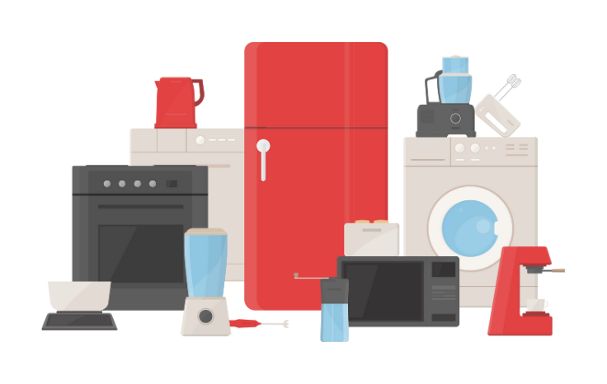
Examples Practical approaches to follow
It's crucial to remember that digital devices still have an environmental impact through energy usage and electronic waste. Therefore, make sure to study the specifications of all technology used, as well as individual circumstances regarding resource use. It is highly possible that in certain scenarios using recycled paper is the most sustainable choice for an educational environment (European Parliament, 2020).

Slide 10
Examples Practical approaches to follow
According to the IT department of the University of Oxford (2022), The greenhouse gas (GHG) emissions from a standard staff desktop and monitor, if used for eight hours, equate to approximately 70g of CO2e due to the electricity consumption.
The most significant factor affecting the total impact of desktop computing is the quantity of devices and monitors procured for each staff member.

Slide 11
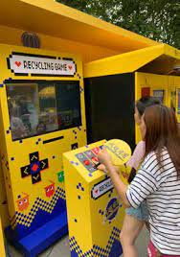
Examples Practical approaches to follow
Waste separation is a crucial part of recycling, a process that can be severely hampered if waste isn't properly divided. Often, people neglect this step either because it adds an extra task or they simply view it as optional, underestimating the significant impact of their choices.
However, there is a far more creative way to approach the problem. The Tongji University in China has been nudging students to sort garbage and recycling properly by installing a sorting game mechanism (Andersen and Halpern, 2020)
This process is called gamification and the potential to make a process enjoyable with game like characteristics can generate high engagement.
Source: Andersen I., Halpern D., (2020)
‘The Little Book of Green Nudges’, UNEP

Slide 12
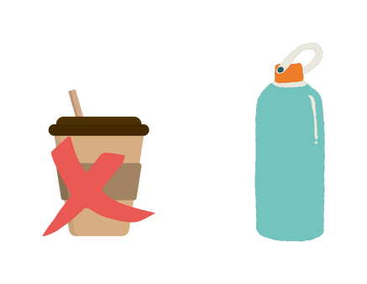
Examples Practical approaches to follow
In cafeterias, VET institutions can use sustainable packaging and promote sustainable food, such as ones that do not have such a massive carbon footprint. This is a good way to introduce the community of VET to new products they would not normally try out.
You may also offer a small discount to students and VET staff bringing their own cups for beverages. This is a measure easy to adopt, because the profit margin for the cafeteria remains proportional, given that the cost of the paper cup is subtracted (WRAP, 2022).

Slide 13
Examples Practical approaches to follow
Moreover, it is recommended that you purchase high quality tools with durability (e.g. glass cutters made of wood or metal instead of plastic). While they are more expensive, they will last for more, which is something to take into account when making a cost - benefit analysis.
Make sure to make a list of what devices and materials must be recycled and which must be repurposed, if they can. High quality tools require different handling in this regard, which should be examined ad hoc, with the appropriate solutions.

Slide 14
Examples Practical approaches to follow
The fact that we do not all live in a campus results most of the time in the use of transportation means. Cycling is a totally sustainable way to ride to work. It does require physical effort, however, which is a reason why many do not prefer it. Some countries implement tax incentive schemes, to encourage employees to cycle to work (Citizens Information, 2023)
Another aspect to consider is water usage. Regular inspections should be conducted to detect and address any leakages. Self closing faucets should be chosen to minimize conventional usage for hand washing.

Slide 15
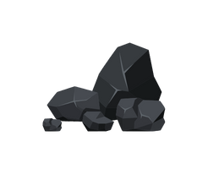
Examples Practical approaches to follow
One of the niche practices to apply is Carbon Offsetting. Carbon offset initiatives are programs that help take out or reduce the amount of CO2, a gas that contributes to climate change, from the air. They do this by supporting activities like planting more trees, creating renewable energy sources like wind and solar power, adopting farming methods that absorb more CO2, and managing waste and landfills better. Out of these, planting more trees is a common way to create carbon offsets.
Those who run these projects can sell carbon offsets to groups, like businesses, who want to balance out the CO2 they themselves release into the air. By buying carbon offsets, they help fund projects that remove or reduce CO2 in other places (Gurgel, 2022).

Slide 16
Examples Practical approaches to follow
In terms of purchasing, your organization can opt for local suppliers to reduce transportation emissions (Fontes, 2016). It is better to choose suppliers with responsible environmental policies and products with sustainable packaging.
It is also highly beneficial to use measuring methods as well. By measuring the organization’s sustainability, through environmental auditing or impact assessments, tracking sustainability is more realistic (FAO, 1996). You can track metrics as KPIs (Key Performance Indicators) and set goals to further motivate behavior.

Slide 17
Assessment – True or False
Providing secure bike parking spaces will increase the use of bicycles True/ False
A company-wide effort to reduce energy consumption is not necessary if its employees are already mindful about turning off all electronics, lights, air-conditioning and heating True/ False
The use of educational material digitally is definitely more sustainable than paper-based material and resources True/False
Buying items in bulk for the workplace can reduce waste and contribute to sustainability True/ False
Setting the office or classroom thermostat a few degrees lower during winter or higher during summer can significantly reduce energy consumption True/ False
Notes:
1, True – People are often discouraged by the fact that it is hard to find a parking spot for their vehicle. By providing a secure spot for parking, they have one obstacle less when deciding how they should go to work
2. False – While it is true that individual efforts are crucial, which is why nudges are implemented in the first place, a company-wide policy can ensure consistency in the implementation of energy-saving practices across the organization and involve large scale changes, such as upgrading the existing HVAC system to a more energy efficient one
3. False – While digital means may not contribute to paper waste, electronic waste and energy consumption may outweigh the benefits of saving paper.
4. True - Purchasing in bulk reduces packaging waste and energy used for transportation
5. True - While it may seem as a small change, heating and cooling can function for as much as 16 or more hours per day, accumulating huge amounts of energy consumption

Slide 18
Assessment – Match the elements
Nudge
Transferability
Cost-benefit analysis
Waste minimisation
Short term versus long-lasting high quality equipment
Habits in VET
Individual Incentives
Subtle policies and suggestions
Recycling and Repurposing
Eco-Consciousness
Notes:
Solutions:
Nudge - Subtle policies and suggestions
Cost-benefit analysis - Short term versus long-lasting high quality equipment
Habits in VET – Transferability
Individual Incentives - Eco-consciousness
Recycling and Repurposing - Waste minimisation

Slide 19
Assessment – Multiple Choice
What does a carbon offset represent? a. A reduction in CO2 emissions that is used to compensate for emissions made elsewhere b. A penalty paid for emitting CO2 c. The amount of CO2 that an individual or company is responsible for emitting
Why is it important for a company to measure and report sustainability performance? a. Maximization of company growth b. Measuring and reporting satisfy employees and increase engagement c. Areas of improvement can be identified
How can you incentivize employees to use reusable bottles for water consumption? a. Do not sell bottled water at vending machines or cafeterias b. Install water coolers and remove plastic cups c. Provide a personalized company bottle with the first name of the employee on it d. b and c
Notes:
Correct answers
A – a
B – b
C – d

Slide 20
Learning Outcomes
Having completed this module you should now be able to:
Experiment with green nudges
Observe the particular needs of your working environment
Suggest custom solutions and approaches

Slide 21
FEEDBACK
Scan the QR Code

Slide 22
List of References
Andersen I., Halpern D., (2020) ‘The Little Book of Green Nudges’, UNEP
Citizens Information (2023) ‘Bike to Work Scheme’, available at: https://www.citizensinformation.ie/en/travel_and_recreation/cycling/cycle_to_work_scheme.html
European Parliament (2020) ‘E-Waste in the EU: facts and figures (infographic), available here
FAO (1996), ‘Environmental impact assessment and environmental auditing in the pulp and paper industry’, FAO Forestry Papers, available at:https://www.fao.org/3/v9933e/V9933E00.htm#TOC
Fast Company (2019), ‘Why compartmentalization is overrated’, available at: https://www.fastcompany.com/90315072/why-you-shouldnt-try-to-compartmentalize-work-and-life
Fontes, J. (2016) ‘Sourcing locally is better: myth or not?’ Pre-Sustainability, available at: https://pre-sustainability.com/articles/sourcing-locally-is-better-myth-or-not/
Gurgel A. (2022) ‘Carbon Offsets’, MIT Climate Portal] available at: https://climate.mit.edu/explainers/carbon-offsets
University of Oxford (2022), ‘Environmental impact of IT: desktops, laptops and screens, University of Oxford IT Services, available at: https://www.it.ox.ac.uk/article/environment-and-it
WRAP, 2022, Green Nudges Playbook, Prepared by Polly Davies, Genevieve Bassett, Mark Roberts and Rachel Gray
All graphic elements were downloaded from Canva and are free to use

